Slide 1
Pakistan Climate Change Factors Analysis

Slide 2
Team Data Stars
Muhammad Yousaf Saddique
Ahmed Rehman Chauhan
Abdul Rahman Jawad
Data Sets
Climate Change Indicators
Temperature
Rainfall

Slide 3
Our story Flow
Population
Deforestation
Increasing Population and Urbanization
Development and Human Settlements near Forest Areas
Precipitation and temperature
Co2 and other gases emission
Irregular Patterns and Severe Climate Conditions
Fossil fuels for energy and industrial production

Slide 4
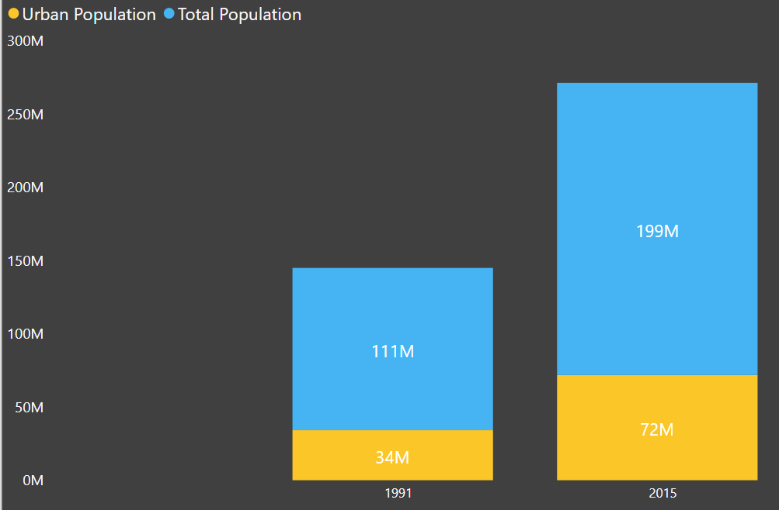
Population Increase
Urban Population
Total population
Duration ➔ 1991 - 2015
Total Population of Pakistan from 111 Million to 199 Million ➔ 80.02% Increase
Urban Population of Pakistan from 34 Million to 72 Million ➔ 110.39% Increase

Slide 5
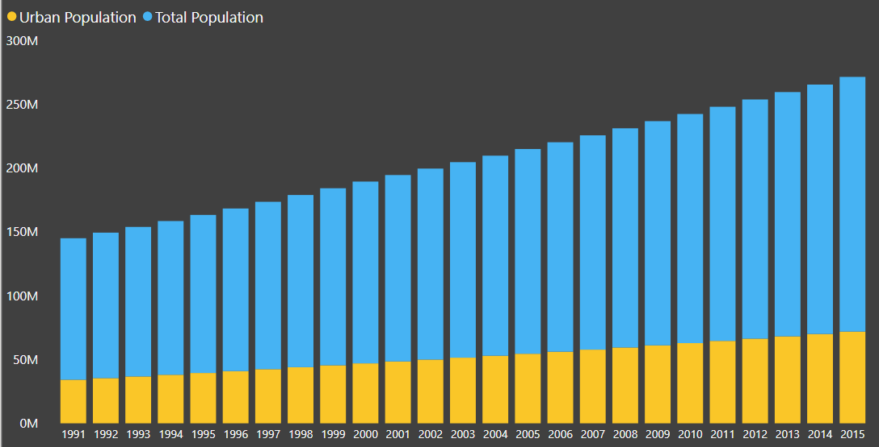
Annual population trend and urbanization
Yearly trend of Population Increase
Urban Population increasing trend due to opportunities and industrialization
Average Annual Population Growth rate from 1991 to 2015 recorded as 2.47%
Population Trend from 1991 to 2015

Slide 6
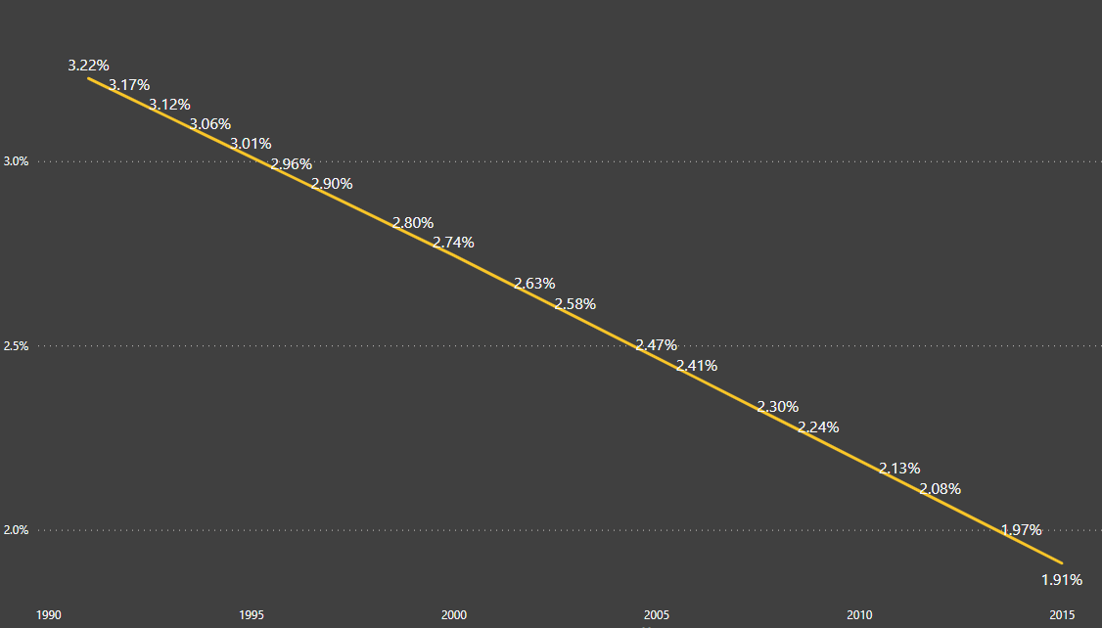
Urbanization and deforestation
Yearly trend of Population Increase
Urban Population increasing trend due to opportunities
Average Annual Population Growth rate from 1991 to 2015 recorded as 2.47%
Percentage Forest Land Area from 1991 to 2015

Slide 7

Effects of deforestation
increased greenhouse gases
Floods, droughts
Drastic climate changes
Soil Erosion

Slide 8
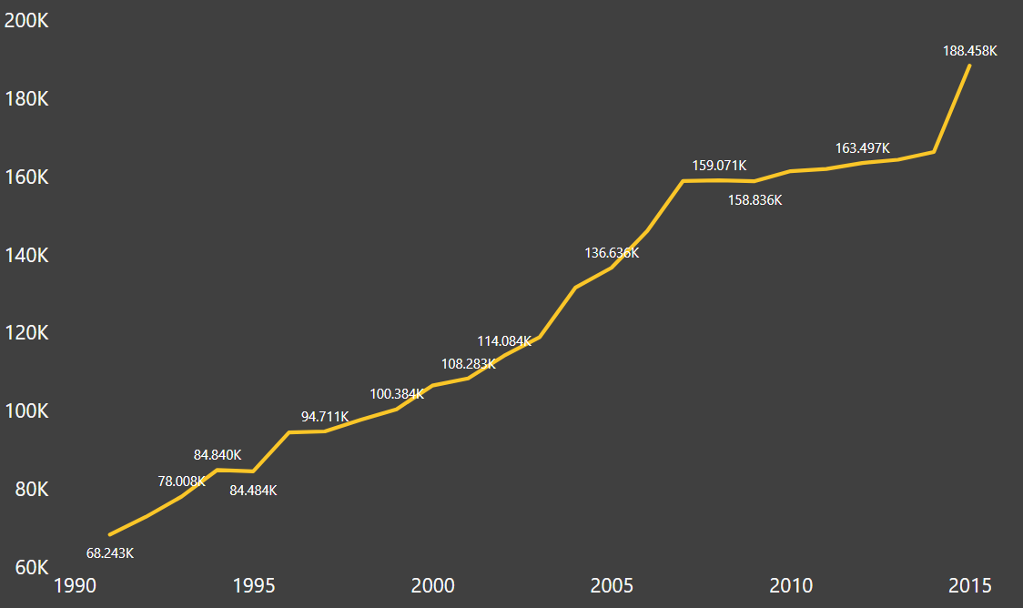
Co2 Emission trend
Drastic increase in CO2 emission due to Industrialization and deforestation
176.16% increase from 1991 to 2015
CO2 emission (kt) from 1991 to 2015

Slide 9

C02 emission sources
Co2 from gaseous fuel sources natural gas
Co2 from Liquid fuel sources like oil
Co2 from Solid fuel sources like coal

Slide 10
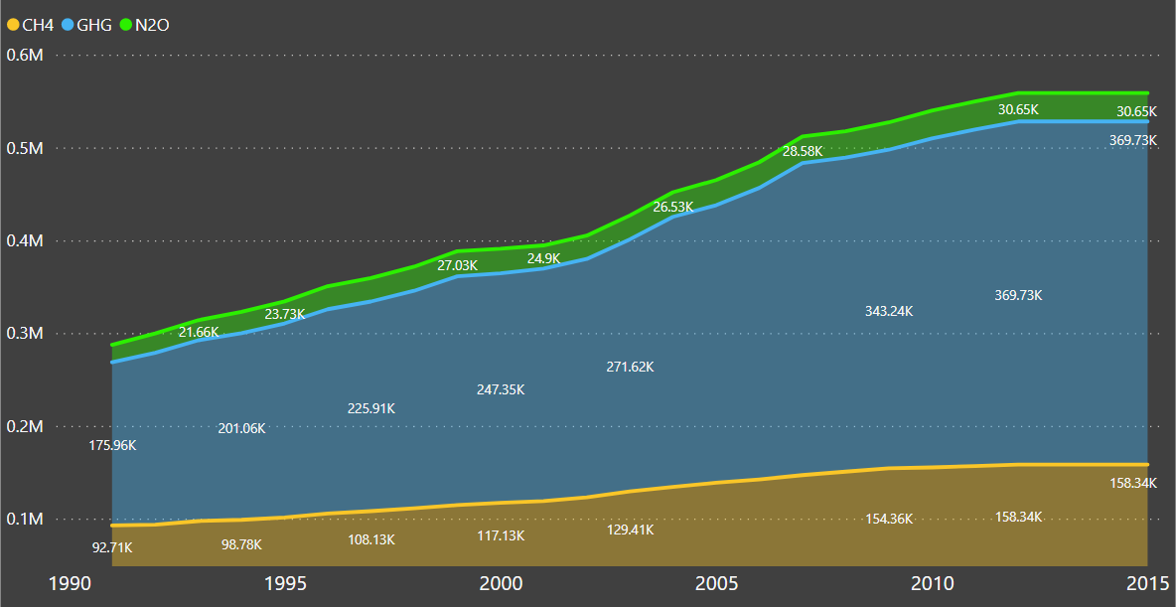
Other harmful gases
Greenhouse gases trapped in the atmosphere
Greenhouse Effect causing
Other Gases emission (kt) from 1991 to 2015

Slide 11
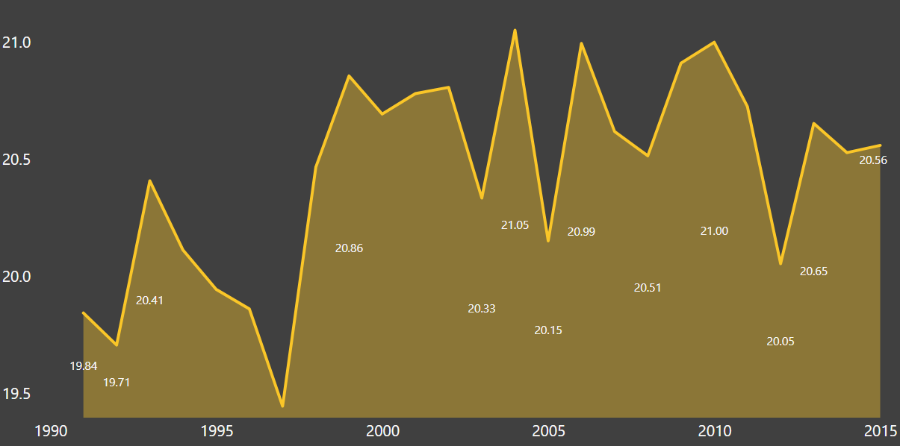
TEMPERATURE variations
With increasing C02 emission, more green house effect results in Global Warming
➔ 20.13 C from 1991 to 2000
➔ 20.65 C from 2001 to 2015
Increase of 0.5 C approx.

Slide 12
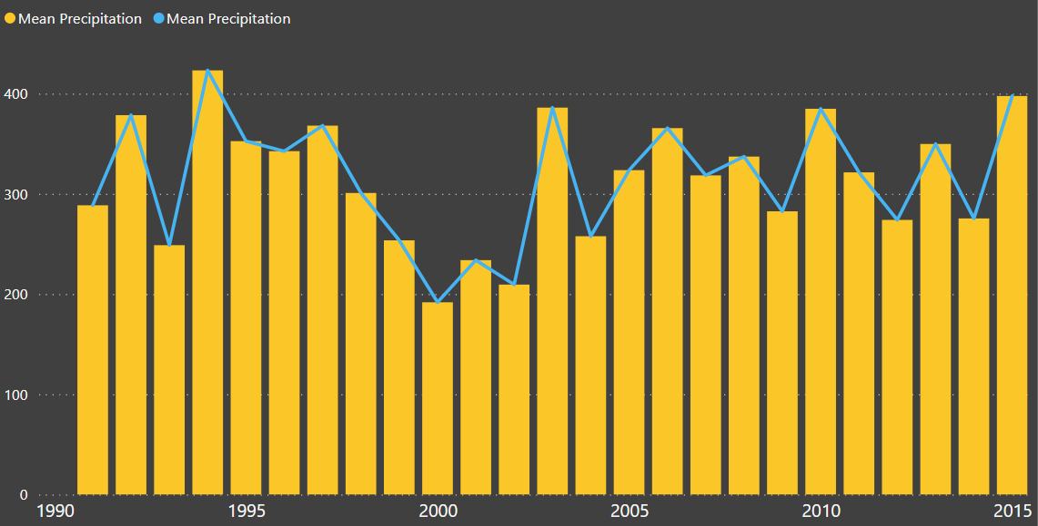
Precipitation variation
Due to increases temperature of Atmosphere, drastic climate and precipitation conditions
➔ 314.90 mm in first 10 years
➔ 306.88 mm last 15 years

Slide 13
Root causes
deforestation
Fossil fuels
Carbon dioxide emissions in Pakistan based on fossil fuel for energy production and industrial purposes.
Alarming rate of deforestation for industries and human colonies

Slide 14
Policy recommedation
Renewable Energy sources
Plantation

Slide 15
Renewable Energy
Limiting the use of fossil fuels such as oil, carbon and natural gas and replacing them with renewable and cleaner sources of energy, all while increasing energy efficiency.
Along with renewable energy sources, short lived climate pollutants from vehicles and other kind of fires should be banned and proper steps should be taken to avoid them

Slide 16
Plantation
Planting trees can help to slow down the process of heat trapping of carbon dioxide in our atmosphere, resulting in a rising climate and contributing to global warming.
The more trees there are, the cleaner the air will be. This is due to the oxygen levels provided by trees

Slide 17
CONCLUSION
Pakistan potentially faces a major climate change challenge. A concerted effort by the government and civil society at all levels is required to mitigate these threats.

Slide 18
THANK You !

